Slide 1
Configuration Model Networks with Power-law degree distribution
MA 653: Network Science
Instructor: Ashok Singh Sairam
ashok@iitg.ac.in

Slide 2
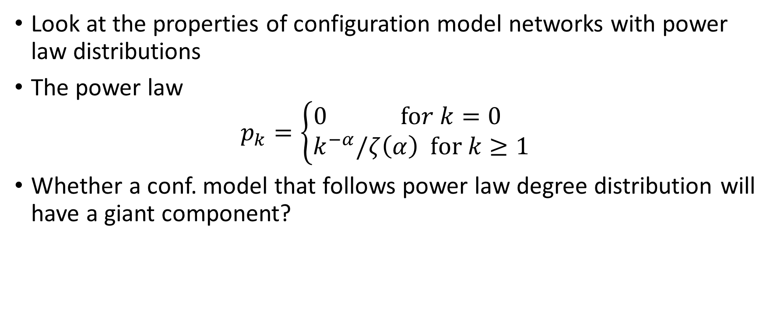
Networks with power-law degree distributions
Look at the properties of configuration model networks with power law distributions
The power law
$$p_{k}=\left\{\begin{matrix}0 \text{fo}r k=0 \\ k^{−α}/ζ\left(α\right) \text{for} k≥1\end{matrix}\right.$$
Whether a conf. model that follows power law degree distribution will have a giant component?

Slide 3
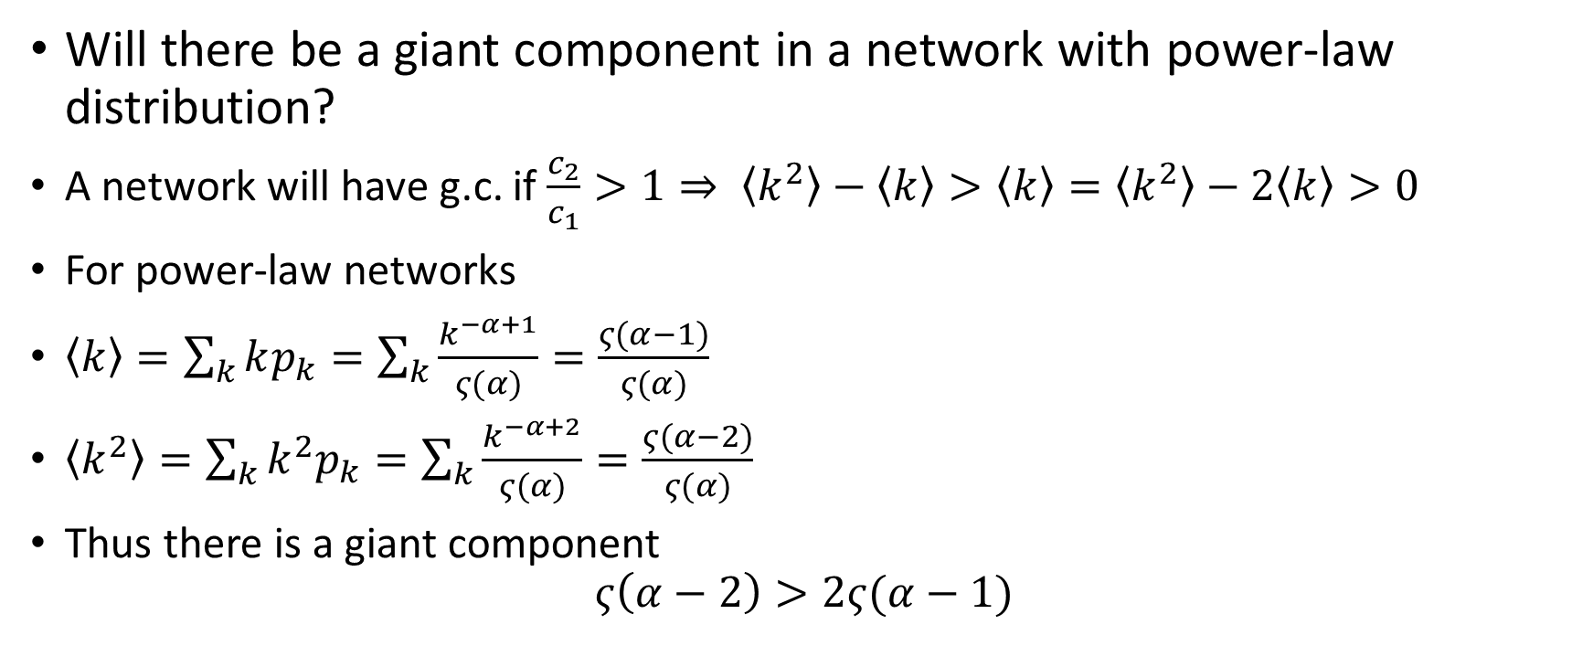
Power-law network: Giant component
Will there be a giant component in a network with power-law distribution?
A network will have g.c. if $\frac{c_{2}}{c_{1}}>1⇒ \left\langle k^{2}\right\rangle −\left\langle k\right\rangle >\left\langle k\right\rangle =\left\langle k^{2}\right\rangle −2\left\langle k\right\rangle >0$
For power-law networks
$\left\langle k\right\rangle =\sum_{k}{kp_{k}=\sum_{k}{\frac{k^{−α+1}}{ς(α)}=\frac{ς(α−1)}{ς(α)}}}$
$\left\langle k^{2}\right\rangle =\sum_{k}{k^{2}p_{k}=\sum_{k}{\frac{k^{−α+2}}{ς(α)}=\frac{ς(α−2)}{ς(α)}}}$
Thus there is a giant component
$$ς\left(α−2\right)>2ς(α−1)$$

Slide 4
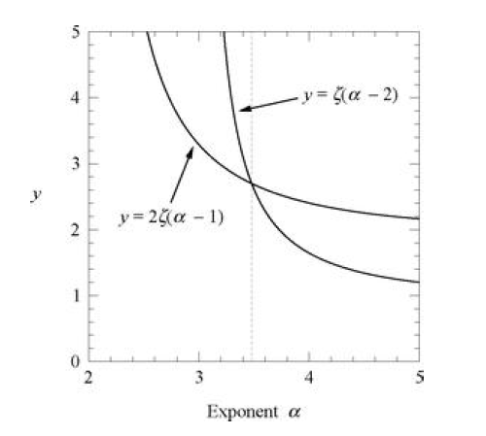
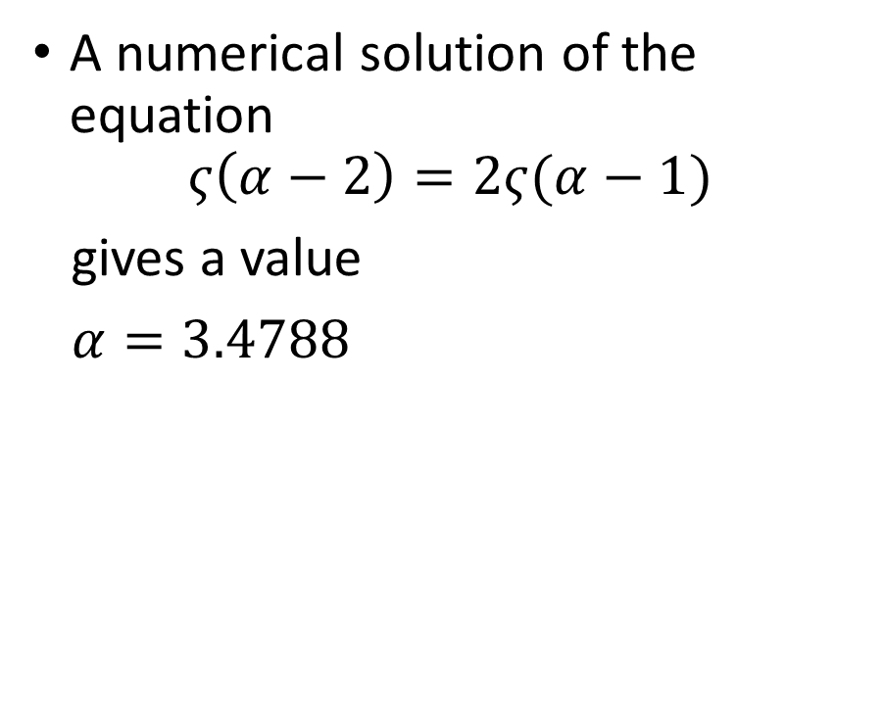
Graphical solution
A numerical solution of the equation
$$ς\left(α−2\right)=2ς(α−1)$$
gives a value
$α=3.4788$

Slide 5
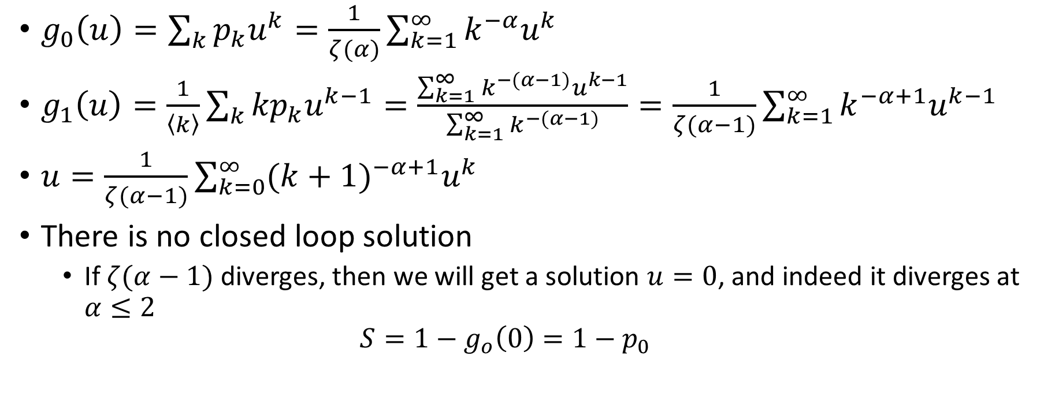
Power law: Giant component
$g_{0}\left(u\right)=\sum_{k}{p_{k}u^{k}}=\frac{1}{ζ(α)}\sum_{k=1}^{∞}{k^{−α}u^{k}}$
$g_{1}\left(u\right)=\frac{1}{\left\langle k\right\rangle }\sum_{k}{{kp}_{k}u^{k−1}=\frac{\sum_{k=1}^{∞}{k^{−(α−1)}u^{k−1}}}{\sum_{k=1}^{∞}{k^{−(α−1)}}}=\frac{1}{ζ(α−1)}\sum_{k=1}^{∞}{k^{−α+1}u^{k−1}}}$
$u=\frac{1}{ζ(α−1)}\sum_{k=0}^{∞}{{(k+1)}^{−α+1}u^{k}}$
There is no closed loop solution
If $ζ(α−1)$ diverges, then we will get a solution $u=0$, and indeed it diverges at $α≤2$
$$S=1−g_{o}\left(0\right)=1−p_{0}$$

Slide 6
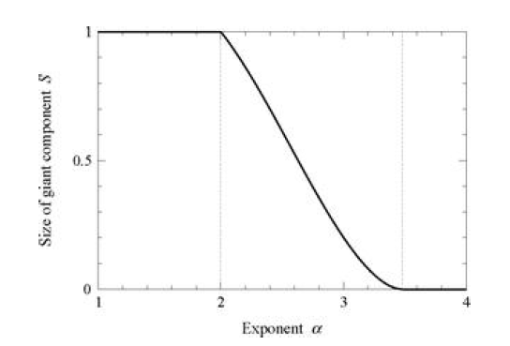
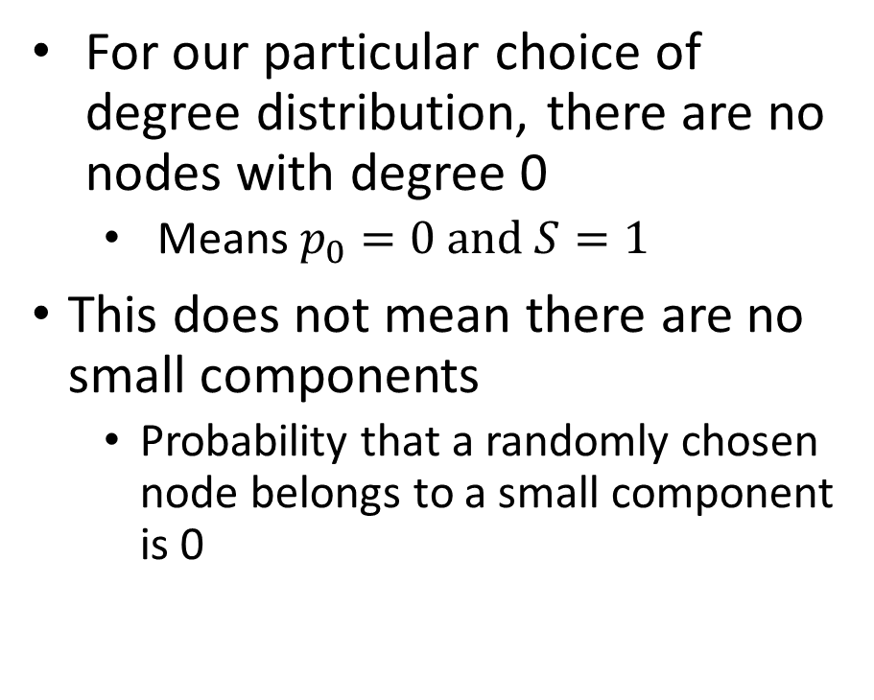
For our particular choice of degree distribution, there are no nodes with degree 0
Means $p_{0}=0 and S=1$
This does not mean there are no small components
Probability that a randomly chosen node belongs to a small component is 0

Slide 7
Diameter of a network with power-law
Consider two nodes i and j
Consider two sets of nodes, those at distance s from i and at distance t from j

Slide 8
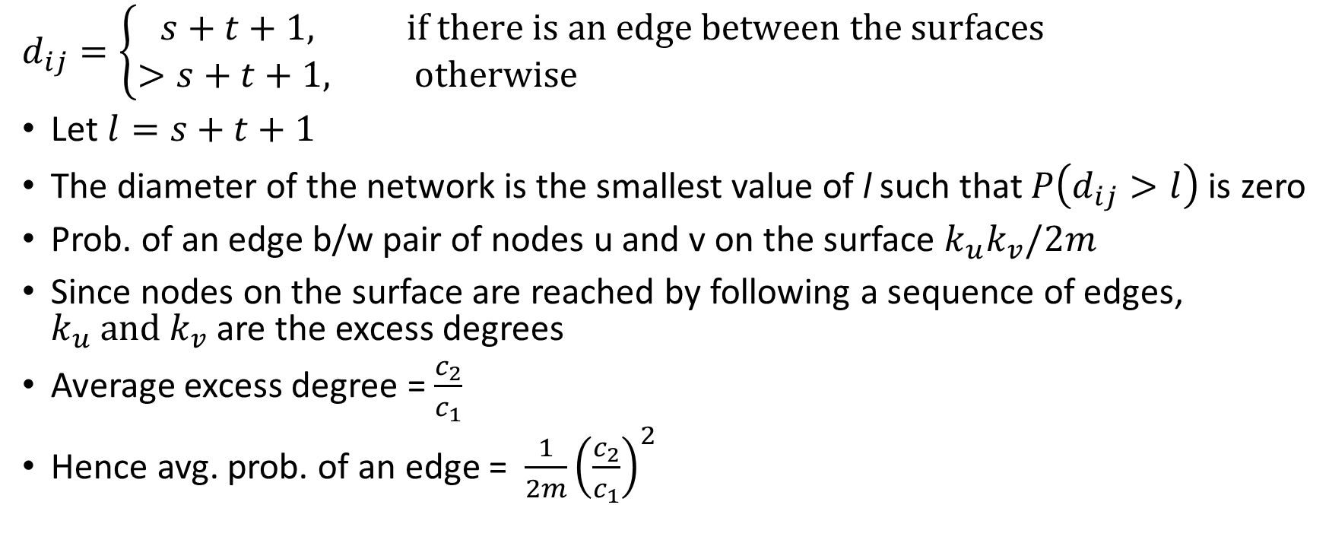
$$d_{ij}=\left\{\begin{aligned}s+t+1, if there is an edge between the surfaces \\ >s+t+1, otherwise \end{aligned}\right.$$
Let $l=s+t+1$
The diameter of the network is the smallest value of l such that $P\left(d_{ij}>l\right)$ is zero
Prob. of an edge b/w pair of nodes u and v on the surface $k_{u}k_{v}/2m$
Since nodes on the surface are reached by following a sequence of edges, $k_{u} and k_{v}$ are the excess degrees
Average excess degree = $\frac{c_{2}}{c_{1}}$
Hence avg. prob. of an edge = ${\frac{1}{2m}\left(\frac{c_{2}}{c_{1}}\right)}^{2}$

Slide 9
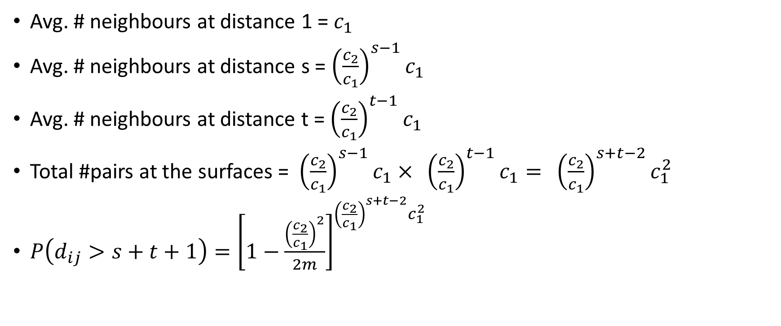
Avg. # neighbours at distance 1 = $c_{1}$
Avg. # neighbours at distance s = ${\left(\frac{c_{2}}{c_{1}}\right)}^{s−1}c_{1}$
Avg. # neighbours at distance t = ${\left(\frac{c_{2}}{c_{1}}\right)}^{t−1}c_{1}$
Total #pairs at the surfaces = ${\left(\frac{c_{2}}{c_{1}}\right)}^{s−1}c_{1}× {\left(\frac{c_{2}}{c_{1}}\right)}^{t−1}c_{1}= {\left(\frac{c_{2}}{c_{1}}\right)}^{s+t−2}c_{1}^{2 }$
$P\left(d_{ij}>s+t+1\right)={\left[1−\frac{{\left(\frac{c_{2}}{c_{1}}\right)}^{2}}{2m}\right]}^{{\left(\frac{c_{2}}{c_{1}}\right)}^{s+t−2}c_{1}^{2 }}$

Slide 10
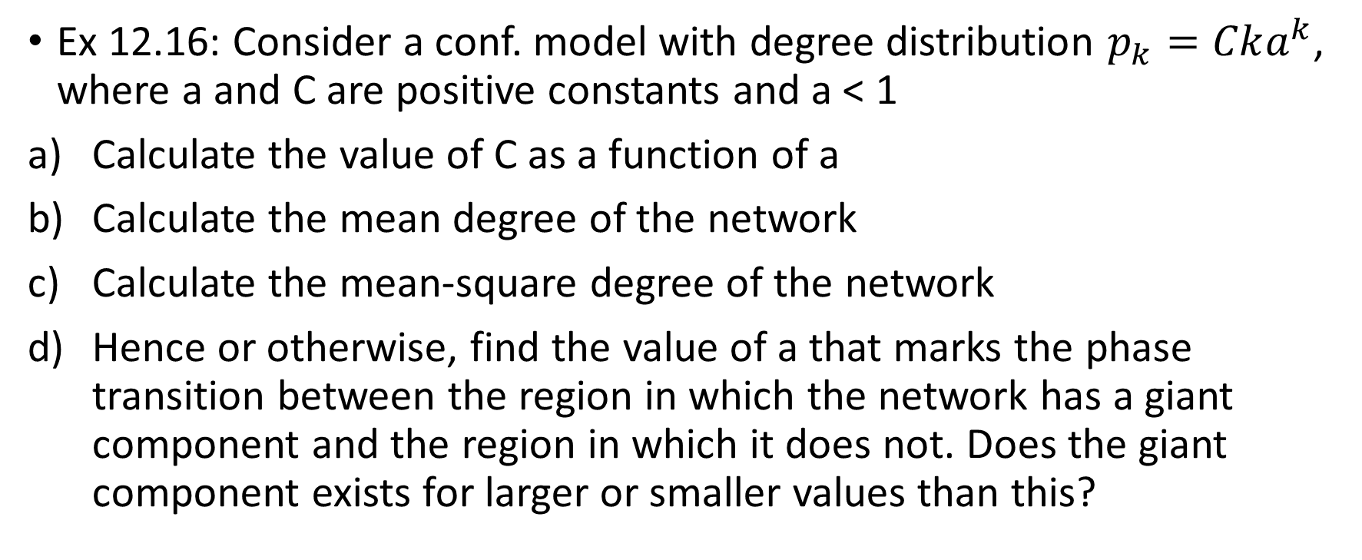
Exercise
Ex 12.16: Consider a conf. model with degree distribution $p_{k}=Cka^{k}$, where a and C are positive constants and a < 1
Calculate the value of C as a function of a
Calculate the mean degree of the network
Calculate the mean-square degree of the network
Hence or otherwise, find the value of a that marks the phase transition between the region in which the network has a giant component and the region in which it does not. Does the giant component exists for larger or smaller values than this?

Slide 11

Exercise
Ex 12.5: Show that in a configuration model network with nodes of degree 2 and greater, but no nodes of degree 0 or 1, there are no small components. (or more properly, the fraction of nodes belonging to such components tend to 0 as $n→∞$)

